Slide 1
ECON1002 Intro. Macro.
Tutorial 8
Herbert Xin
wei.xin@sydney.edu.au

Slide 2
Plan of Today
Tutorial Questions
Question 1, 4, 5
Preparation for Essay Task
Due: May 11th
3. Midsemester Exam
Result should be out late this week

Slide 3
Tutorial Questions

Slide 4
Question 1
Real GDP is $8 trillion, nominal GDP is $10 trillion, M1 is $2 trillion, and M3 is $5 trillion.

Slide 5
Question 1
Real GDP is $8 trillion, nominal GDP is $10 trillion, M1 is $2 trillion, and M3 is $5 trillion.
a. Find velocity for M1 and for M3.

Slide 6
Question 1
Real GDP is $8 trillion, nominal GDP is $10 trillion, M1 is $2 trillion, and M3 is $5 trillion.
a. Find velocity for M1 and for M3.
M1 – Currency + Current bank deposits
M3 – M1 + Deposits of private non-banks

Slide 7
Question 1
Real GDP is $8 trillion, nominal GDP is $10 trillion, M1 is $2 trillion, and M3 is $5 trillion.
a. Find velocity for M1 and for M3.
M1 – Currency + Current bank deposits
M3 – M1 + Deposits of private non-banks
Quantity theory of money

Slide 8
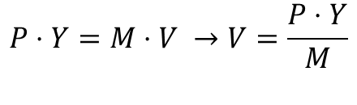
Question 1
Real GDP is $8 trillion, nominal GDP is $10 trillion, M1 is $2 trillion, and M3 is $5 trillion.
a. Find velocity for M1 and for M3.
M1 – Currency + Current bank deposits
M3 – M1 + Deposits of private non-banks
Quantity theory of money
$$P⋅Y=M⋅V →V=\frac{P⋅Y}{M}$$

Slide 9
Question 1
Real GDP is $8 trillion, nominal GDP is $10 trillion, M1 is $2 trillion, and M3 is $5 trillion.
a. Find velocity for M1 and for M3.
M1 – Currency + Current bank deposits
M3 – M1 + Deposits of private non-banks
Quantity theory of money
$$P⋅Y=M⋅V →V=\frac{P⋅Y}{M}$$
Velocity
Price level
Money Base
Real GDP

Slide 10


Question 1
Real GDP is $8 trillion, nominal GDP is $10 trillion, M1 is $2 trillion, and M3 is $5 trillion.
a. Find velocity for M1 and for M3.
M1 – Currency + Current bank deposits
M3 – M1 + Deposits of private non-banks
Quantity theory of money
$$P⋅Y=M⋅V →V=\frac{P⋅Y}{M}$$
Real GDP: $Y=8$
Nominal GDP: $P⋅Y=10$
Velocity
Price level
Money Base
Real GDP

Slide 11
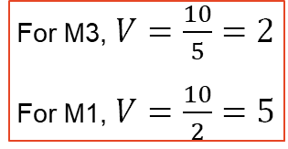
Question 1
Real GDP is $8 trillion, nominal GDP is $10 trillion, M1 is $2 trillion, and M3 is $5 trillion.
a. Find velocity for M1 and for M3.
M1 – Currency + Current bank deposits
M3 – M1 + Deposits of private non-banks
Quantity theory of money
$$P⋅Y=M⋅V →V=\frac{P⋅Y}{M}$$
Real GDP: $Y=8$
Nominal GDP: $P⋅Y=10$
Velocity
For M3, $V=\frac{10}{5}=2$
For M1, $V=\frac{10}{2}=5$
Price level
Money Base
Real GDP

Slide 12
Question 1
Real GDP is $8 trillion, nominal GDP is $10 trillion, M1 is $2 trillion, and M3 is $5 trillion.
b. Show that the quantity equation holds for both M1 and M3.

Slide 13

Question 1
Real GDP is $8 trillion, nominal GDP is $10 trillion, M1 is $2 trillion, and M3 is $5 trillion.
b. Show that the quantity equation holds for both M1 and M3.
What a question! Basically asking you show the reverse works, i.e.
$$V⋅M=P⋅Y$$

Slide 14
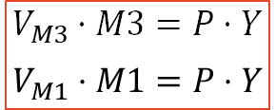
Question 1
Real GDP is $8 trillion, nominal GDP is $10 trillion, M1 is $2 trillion, and M3 is $5 trillion.
b. Show that the quantity equation holds for both M1 and M3.
What a question! Basically asking you show the reverse works, i.e.
$$V_{M3}⋅M3=P⋅Y$$
$$V_{M1}⋅M1=P⋅Y$$
$$V⋅M=P⋅Y$$

Slide 15






Question 4
An economy is described by the following equations.
a. Find a numerical equation relating planned aggregate expenditure to output and to the real
interest rate
$$C=14,400+0.5\left(Y−T\right)−40,000r$$
$$I^{P}=8, 000−20,000r$$
$$G=7,000$$
$$X=0$$
$$M=1,800$$
$$T=8,000$$
$$Y^{∗}=40,000$$

Slide 16
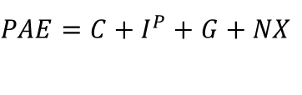
Question 4
An economy is described by the following equations.
a. Find a numerical equation relating planned aggregate expenditure to output and to the real
interest rate
$$C=14,400+0.5\left(Y−T\right)−40,000r$$
$$PAE=C+I^{P}+G+NX$$
$$I^{P}=8, 000−20,000r$$
$$G=7,000$$
$$X=0$$
$$M=1,800$$
$$T=8,000$$
$$Y^{∗}=40,000$$

Slide 17
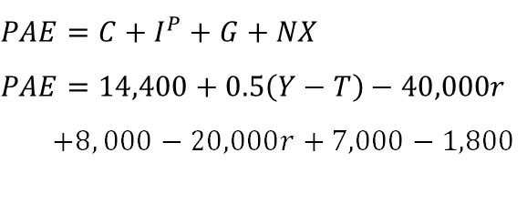
Question 4
An economy is described by the following equations.
a. Find a numerical equation relating planned aggregate expenditure to output and to the real
interest rate
$$C=14,400+0.5\left(Y−T\right)−40,000r$$
$$PAE=C+I^{P}+G+NX$$
$$PAE=14,400+0.5\left(Y−T\right)−40,000r$$
$+8, 000−20,000r+7,000−1,800$
$$I^{P}=8, 000−20,000r$$
$$G=7,000$$
$$X=0$$
$$M=1,800$$
$$T=8,000$$
$$Y^{∗}=40,000$$

Slide 18
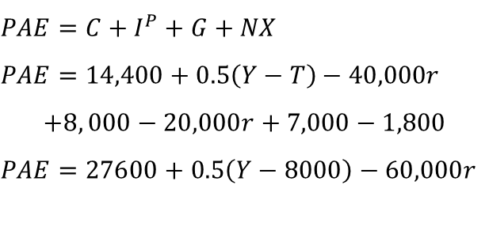
Question 4
An economy is described by the following equations.
a. Find a numerical equation relating planned aggregate expenditure to output and to the real
interest rate
$$C=14,400+0.5\left(Y−T\right)−40,000r$$
$$PAE=C+I^{P}+G+NX$$
$$PAE=14,400+0.5\left(Y−T\right)−40,000r$$
$$+8, 000−20,000r+7,000−1,800$$
$$PAE=27600+0.5\left(Y−8000\right)−60,000r$$
$$I^{P}=8, 000−20,000r$$
$$G=7,000$$
$$X=0$$
$$M=1,800$$
$$T=8,000$$
$$Y^{∗}=40,000$$

Slide 19
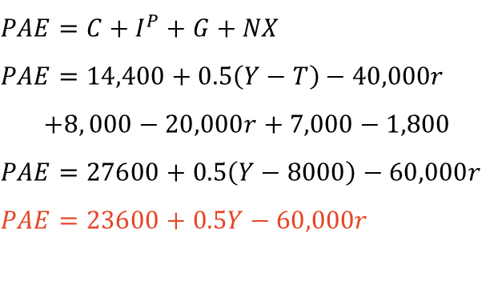
Question 4
An economy is described by the following equations.
a. Find a numerical equation relating planned aggregate expenditure to output and to the real
interest rate
$$C=14,400+0.5\left(Y−T\right)−40,000r$$
$$PAE=C+I^{P}+G+NX$$
$$PAE=14,400+0.5\left(Y−T\right)−40,000r$$
$$+8, 000−20,000r+7,000−1,800$$
$$PAE=27600+0.5\left(Y−8000\right)−60,000r$$
$$PAE=23600+0.5Y−60,000r$$
$$I^{P}=8, 000−20,000r$$
$$G=7,000$$
$$X=0$$
$$M=1,800$$
$$T=8,000$$
$$Y^{∗}=40,000$$

Slide 20
Question 4
An economy is described by the following equations.
b. At what value should the Reserve Bank set the real interest rate to eliminate the output
gap?
$$C=14,400+0.5\left(Y−T\right)−40,000r$$
$$I^{P}=8, 000−20,000r$$
$$G=7,000$$
$$X=0$$
$$M=1,800$$
$$T=8,000$$
$$Y^{∗}=40,000$$

Slide 21

Question 4
An economy is described by the following equations.
b. At what value should the Reserve Bank set the real interest rate to eliminate the output
gap?
$$PAE=23,600+0.5Y−60,000r$$
$$C=14,400+0.5\left(Y−T\right)−40,000r$$
$$I^{P}=8, 000−20,000r$$
$$G=7,000$$
$$X=0$$
$$M=1,800$$
$$T=8,000$$
$$Y^{∗}=40,000$$

Slide 22
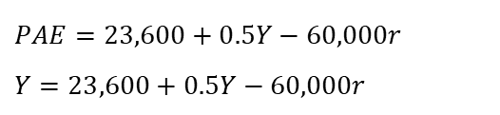
Question 4
An economy is described by the following equations.
b. At what value should the Reserve Bank set the real interest rate to eliminate the output
gap?
$$PAE=23,600+0.5Y−60,000r$$
$$Y=23,600+0.5Y−60,000r$$
$$C=14,400+0.5\left(Y−T\right)−40,000r$$
$$I^{P}=8, 000−20,000r$$
$$G=7,000$$
$$X=0$$
$$M=1,800$$
$$T=8,000$$
$$Y^{∗}=40,000$$

Slide 23
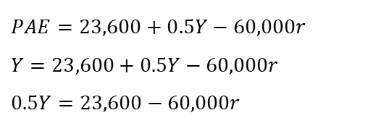
Question 4
An economy is described by the following equations.
b. At what value should the Reserve Bank set the real interest rate to eliminate the output
gap?
$$PAE=23,600+0.5Y−60,000r$$
$$Y=23,600+0.5Y−60,000r$$
$$0.5Y=23,600−60,000r$$
$$C=14,400+0.5\left(Y−T\right)−40,000r$$
$$I^{P}=8, 000−20,000r$$
$$G=7,000$$
$$X=0$$
$$M=1,800$$
$$T=8,000$$
$$Y^{∗}=40,000$$

Slide 24
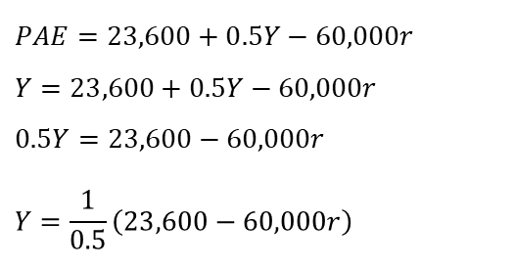
Question 4
An economy is described by the following equations.
b. At what value should the Reserve Bank set the real interest rate to eliminate the output
gap?
$$PAE=23,600+0.5Y−60,000r$$
$$Y=23,600+0.5Y−60,000r$$
$$0.5Y=23,600−60,000r$$
$$Y=\frac{1}{0.5}\left(23,600−60,000r\right)$$
$$C=14,400+0.5\left(Y−T\right)−40,000r$$
$$I^{P}=8, 000−20,000r$$
$$G=7,000$$
$$X=0$$
$$M=1,800$$
$$T=8,000$$
$$Y^{∗}=40,000$$

Slide 25
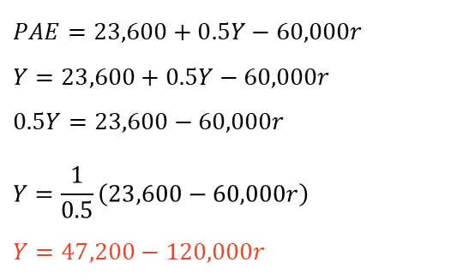
Question 4
An economy is described by the following equations.
b. At what value should the Reserve Bank set the real interest rate to eliminate the output
gap?
$$PAE=23,600+0.5Y−60,000r$$
$$Y=23,600+0.5Y−60,000r$$
$$0.5Y=23,600−60,000r$$
$$Y=\frac{1}{0.5}\left(23,600−60,000r\right)$$
$$Y=47,200−120,000r$$
$$C=14,400+0.5\left(Y−T\right)−40,000r$$
$$I^{P}=8, 000−20,000r$$
$$G=7,000$$
$$X=0$$
$$M=1,800$$
$$T=8,000$$
$$Y^{∗}=40,000$$

Slide 26
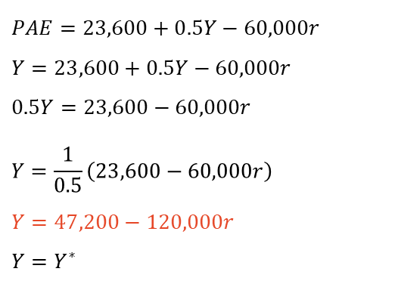
Question 4
An economy is described by the following equations.
b. At what value should the Reserve Bank set the real interest rate to eliminate the output
gap?
$$PAE=23,600+0.5Y−60,000r$$
$$Y=23,600+0.5Y−60,000r$$
$$0.5Y=23,600−60,000r$$
$$Y=\frac{1}{0.5}\left(23,600−60,000r\right)$$
$$Y=47,200−120,000r$$
$$Y=Y^{∗}$$
$$C=14,400+0.5\left(Y−T\right)−40,000r$$
$$I^{P}=8, 000−20,000r$$
$$G=7,000$$
$$X=0$$
$$M=1,800$$
$$T=8,000$$
$$Y^{∗}=40,000$$

Slide 27
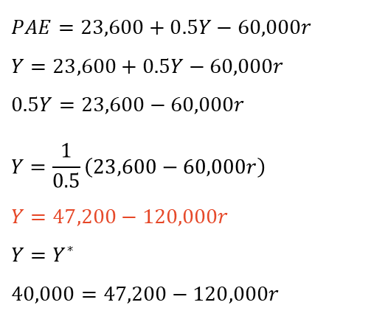
Question 4
An economy is described by the following equations.
b. At what value should the Reserve Bank set the real interest rate to eliminate the output
gap?
$$PAE=23,600+0.5Y−60,000r$$
$$Y=23,600+0.5Y−60,000r$$
$$0.5Y=23,600−60,000r$$
$$Y=\frac{1}{0.5}\left(23,600−60,000r\right)$$
$$Y=47,200−120,000r$$
$$Y=Y^{∗}$$
$$40,000=47,200−120,000r$$
$$C=14,400+0.5\left(Y−T\right)−40,000r$$
$$I^{P}=8, 000−20,000r$$
$$G=7,000$$
$$X=0$$
$$M=1,800$$
$$T=8,000$$
$$Y^{∗}=40,000$$

Slide 28
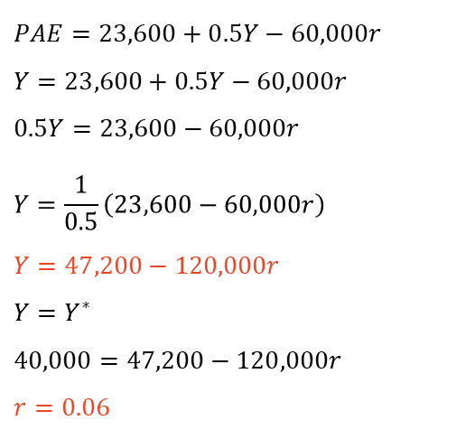
Question 4
An economy is described by the following equations.
b. At what value should the Reserve Bank set the real interest rate to eliminate the output
gap?
$$PAE=23,600+0.5Y−60,000r$$
$$Y=23,600+0.5Y−60,000r$$
$$0.5Y=23,600−60,000r$$
$$Y=\frac{1}{0.5}\left(23,600−60,000r\right)$$
$$Y=47,200−120,000r$$
$$Y=Y^{∗}$$
$$40,000=47,200−120,000r$$
$$r=0.06$$
$$C=14,400+0.5\left(Y−T\right)−40,000r$$
$$I^{P}=8, 000−20,000r$$
$$G=7,000$$
$$X=0$$
$$M=1,800$$
$$T=8,000$$
$$Y^{∗}=40,000$$

Slide 29
Preparation for Essay Task

Slide 30
Question 5
Enter the following statement in Microsoft Bing Copilot: “Explain why interest rates have recently been raised in Australia.” I would add in 4 paragraphs so it does not write a thesis.

Slide 31
Question 5
Enter the following statement in Microsoft Bing Copilot: “Explain why interest rates have recently been raised in Australia.” I would add in 4 paragraphs so it does not write a thesis.
Engage in a conversation with Bing Copilot so it gives the most accurate response

Slide 32
Question 5
Enter the following statement in Microsoft Bing Copilot: “Explain why interest rates have recently been raised in Australia.” I would add in 4 paragraphs so it does not write a thesis.
Engage in a conversation with Bing Copilot so it gives the most accurate response
Think how the response you got could be further improved

Slide 33
Question 5
Enter the following statement in Microsoft Bing Copilot: “Explain why interest rates have recently been raised in Australia.” I would add in 4 paragraphs so it does not write a thesis.
Engage in a conversation with Bing Copilot so it gives the most accurate response
Think how the response you got could be further improved
Think of extra explanation and analysis using relevant theories, graphs, equations, or other evidence.

Slide 34
Questions?

Slide 35




Question 2
An economy is described by the following equations.
a. Find a numerical equation relating planned aggregate expenditure to output. Solve for short run equilibrium output. Show your results graphically using the Keynesian cross diagram.
$$C=2600+0.8\left(Y−T\right)−10,000r$$
$$I^{P}=2000−10,000r$$
$$G=1800$$
$$NX=0$$
$$T=3000$$
The real interest rate, expressed as a decimal, is 0.10 (that is, 10 percent)

Slide 36

Question 2
An economy is described by the following equations.
a. Find a numerical equation relating planned aggregate expenditure to output. Solve for short run equilibrium output. Show your results graphically using the Keynesian cross diagram.
$$C=2600+0.8\left(Y−T\right)−10,000r$$
$$Y=PAE=C+I^{P}+G+NX$$
$$I^{P}=2000−10,000r$$
$$G=1800$$
$$NX=0$$
$$T=3000$$
The real interest rate, expressed as a decimal, is 0.10 (that is, 10 percent)

Slide 37

Question 2
An economy is described by the following equations.
a. Find a numerical equation relating planned aggregate expenditure to output. Solve for short run equilibrium output. Show your results graphically using the Keynesian cross diagram.
$$C=2600+0.8\left(Y−T\right)−10,000r$$
$$Y=PAE=C+I^{P}+G+NX$$
$$I^{P}=2000−10,000r$$
$$Y=2600+0.8\left(Y−3000\right)−10,000r$$
$$+2000−10,000r+1800$$
$$G=1800$$
$$NX=0$$
$$T=3000$$
The real interest rate, expressed as a decimal, is 0.10 (that is, 10 percent)

Slide 38
Question 2
An economy is described by the following equations.
a. Find a numerical equation relating planned aggregate expenditure to output. Solve for short run equilibrium output. Show your results graphically using the Keynesian cross diagram.
$$C=2600+0.8\left(Y−T\right)−10,000r$$
$$Y=PAE=C+I^{P}+G+NX$$
$$I^{P}=2000−10,000r$$
$$Y=2600+0.8\left(Y−3000\right)−10,000r$$
$$+2000−10,000r+1800$$
$$G=1800$$
$$NX=0$$
$$Y=6400+0.8\left(Y−3000\right)−20,000r$$
$$T=3000$$
The real interest rate, expressed as a decimal, is 0.10 (that is, 10 percent)

Slide 39

Question 2
An economy is described by the following equations.
a. Find a numerical equation relating planned aggregate expenditure to output. Solve for short run equilibrium output. Show your results graphically using the Keynesian cross diagram.
$$C=2600+0.8\left(Y−T\right)−10,000r$$
$$Y=PAE=C+I^{P}+G+NX$$
$$I^{P}=2000−10,000r$$
$$Y=2600+0.8\left(Y−3000\right)−10,000r$$
$$+2000−10,000r+1800$$
$$G=1800$$
$$NX=0$$
$$Y=6400+0.8\left(Y−3000\right)−20,000r$$
$$T=3000$$
$$Y=4000+0.8Y−20,000r$$
The real interest rate, expressed as a decimal, is 0.10 (that is, 10 percent)

Slide 40

Question 2
An economy is described by the following equations.
a. Find a numerical equation relating planned aggregate expenditure to output. Solve for short run equilibrium output. Show your results graphically using the Keynesian cross diagram.
$$C=2600+0.8\left(Y−T\right)−10,000r$$
$$Y=PAE=C+I^{P}+G+NX$$
$$I^{P}=2000−10,000r$$
$$Y=2600+0.8\left(Y−3000\right)−10,000r$$
$$+2000−10,000r+1800$$
$$G=1800$$
$$NX=0$$
$$Y=6400+0.8\left(Y−3000\right)−20,000r$$
$$T=3000$$
$$Y=4000+0.8Y−20,000r$$
The real interest rate, expressed as a decimal, is 0.10 (that is, 10 percent)
$$0.2Y=4000−20,000r$$

Slide 41

Question 2
An economy is described by the following equations.
a. Find a numerical equation relating planned aggregate expenditure to output. Solve for short run equilibrium output. Show your results graphically using the Keynesian cross diagram.
$$C=2600+0.8\left(Y−T\right)−10,000r$$
$$Y=PAE=C+I^{P}+G+NX$$
$$I^{P}=2000−10,000r$$
$$Y=2600+0.8\left(Y−3000\right)−10,000r$$
$$+2000−10,000r+1800$$
$$G=1800$$
$$NX=0$$
$$Y=6400+0.8\left(Y−3000\right)−20,000r$$
$$T=3000$$
$$Y=4000+0.8Y−20,000r$$
The real interest rate, expressed as a decimal, is 0.10 (that is, 10 percent)
$$0.2Y=4000−20,000r$$
$$Y=\frac{1}{0.2}(4000−20,000r)$$

Slide 42
Question 2
An economy is described by the following equations.
a. Find a numerical equation relating planned aggregate expenditure to output. Solve for short run equilibrium output. Show your results graphically using the Keynesian cross diagram.
$$C=2600+0.8\left(Y−T\right)−10,000r$$
$$Y=PAE=C+I^{P}+G+NX$$
$$I^{P}=2000−10,000r$$
$$Y=2600+0.8\left(Y−3000\right)−10,000r$$
$$+2000−10,000r+1800$$
$$G=1800$$
$$NX=0$$
$$Y=6400+0.8\left(Y−3000\right)−20,000r$$
$$T=3000$$
$$Y=4000+0.8Y−20,000r$$
The real interest rate, expressed as a decimal, is 0.10 (that is, 10 percent)
$$0.2Y=4000−20,000r$$
$$Y=\frac{1}{0.2}(4000−20,000r)$$

Slide 43
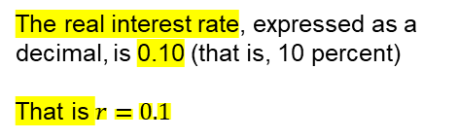
Question 2
An economy is described by the following equations.
a. Find a numerical equation relating planned aggregate expenditure to output. Solve for short run equilibrium output. Show your results graphically using the Keynesian cross diagram.
$$C=2600+0.8\left(Y−T\right)−10,000r$$
$$Y=PAE=C+I^{P}+G+NX$$
$$I^{P}=2000−10,000r$$
$$Y=2600+0.8\left(Y−3000\right)−10,000r$$
$$+2000−10,000r+1800$$
$$G=1800$$
$$NX=0$$
$$Y=6400+0.8\left(Y−3000\right)−20,000r$$
$$T=3000$$
$$Y=4000+0.8Y−20,000r$$
The real interest rate, expressed as a decimal, is 0.10 (that is, 10 percent)
That is $r=0.1$
$$0.2Y=4000−20,000r$$
$$Y=\frac{1}{0.2}(4000−20,000r)$$

Slide 44

Question 2
An economy is described by the following equations.
a. Find a numerical equation relating planned aggregate expenditure to output. Solve for short run equilibrium output. Show your results graphically using the Keynesian cross diagram.
$$C=2600+0.8\left(Y−T\right)−10,000r$$
$$Y=PAE=C+I^{P}+G+NX$$
$$I^{P}=2000−10,000r$$
$$Y=2600+0.8\left(Y−3000\right)−10,000r$$
$$+2000−10,000r+1800$$
$$G=1800$$
$$NX=0$$
$$Y=6400+0.8\left(Y−3000\right)−20,000r$$
$$T=3000$$
$$Y=4000+0.8Y−20,000r$$
The real interest rate, expressed as a decimal, is 0.10 (that is, 10 percent)
That is $r=0.1$
$$0.2Y=4000−20,000r$$
$$Y=\frac{1}{0.2}(4000−20,000r)$$
$$Y=\frac{1}{0.2}\left(4000−20,000⋅0.1\right)=10,000$$

Slide 45
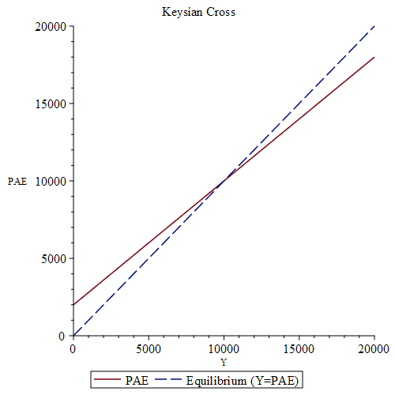
Question 2
An economy is described by the following equations.
a. Find a numerical equation relating planned aggregate expenditure to output. Solve for short run equilibrium output. Show your results graphically using the Keynesian cross diagram.
$$C=2600+0.8\left(Y−T\right)−10,000r$$
$$I^{P}=2000−10,000r$$
$$G=1800$$
$$NX=0$$
$$T=3000$$
The real interest rate, expressed as a decimal, is 0.10 (that is, 10 percent)
That is $r=0.1$

Slide 46
Question 2
An economy is described by the following equations.
b. Potential output Y* equals 12,000. What real interest rate should the Reserve Bank set to bring the economy to full employment? You may take as given that the multiplier for this economy is 5.
$$C=2600+0.8\left(Y−T\right)−10,000r$$
$$I^{P}=2000−10,000r$$
$$G=1800$$
$$NX=0$$
$$T=3000$$
The real interest rate, expressed as a decimal, is 0.10 (that is, 10 percent)

Slide 47
Question 2
An economy is described by the following equations.
b. Potential output Y* equals 12,000. What real interest rate should the Reserve Bank set to bring the economy to full employment? You may take as given that the multiplier for this economy is 5.
$$C=2600+0.8\left(Y−T\right)−10,000r$$
$ΔY=$ Multiplier$⋅$ Coef Exo-var$⋅Δ$(Exo-var)
$$I^{P}=2000−10,000r$$
$$G=1800$$
$$NX=0$$
$$T=3000$$
The real interest rate, expressed as a decimal, is 0.10 (that is, 10 percent)

Slide 48


Question 2
An economy is described by the following equations.
b. Potential output Y* equals 12,000. What real interest rate should the Reserve Bank set to bring the economy to full employment? You may take as given that the multiplier for this economy is 5.
$$C=2600+0.8\left(Y−T\right)−10,000r$$
$ΔY=$ Multiplier$⋅$ Coef Exo-var$⋅Δ$(Exo-var)
$$I^{P}=2000−10,000r$$
$ΔY=$ Multiplier$⋅−20,000⋅Δr$
$$G=1800$$
$$NX=0$$
$$T=3000$$
The real interest rate, expressed as a decimal, is 0.10 (that is, 10 percent)

Slide 49

Question 2
An economy is described by the following equations.
b. Potential output Y* equals 12,000. What real interest rate should the Reserve Bank set to bring the economy to full employment? You may take as given that the multiplier for this economy is 5.
$$C=2600+0.8\left(Y−T\right)−10,000r$$
$ΔY=$ Multiplier$⋅$ Coef Exo-var$⋅Δ$(Exo-var)
$$I^{P}=2000−10,000r$$
$ΔY=$ Multiplier$⋅−20,000⋅Δr$
$$G=1800$$
$$Y=10,000, Y^{∗}=12,000 →ΔY=2,000$$
$$NX=0$$
$$T=3000$$
The real interest rate, expressed as a decimal, is 0.10 (that is, 10 percent)

Slide 50

Question 2
An economy is described by the following equations.
b. Potential output Y* equals 12,000. What real interest rate should the Reserve Bank set to bring the economy to full employment? You may take as given that the multiplier for this economy is 5.
$$C=2600+0.8\left(Y−T\right)−10,000r$$
$ΔY=$ Multiplier$⋅$ Coef Exo-var$⋅Δ$(Exo-var)
$$I^{P}=2000−10,000r$$
$ΔY=$ Multiplier$⋅−20,000⋅Δr$
$$G=1800$$
$$Y=10,000, Y^{∗}=12,000 →ΔY=2,000$$
$$NX=0$$
$$2,000=5⋅−20,000⋅Δr$$
$$T=3000$$
The real interest rate, expressed as a decimal, is 0.10 (that is, 10 percent)

Slide 51

Question 2
An economy is described by the following equations.
b. Potential output Y* equals 12,000. What real interest rate should the Reserve Bank set to bring the economy to full employment? You may take as given that the multiplier for this economy is 5.
$$C=2600+0.8\left(Y−T\right)−10,000r$$
$ΔY=$ Multiplier$⋅$ Coef Exo-var$⋅Δ$(Exo-var)
$$I^{P}=2000−10,000r$$
$ΔY=$ Multiplier$⋅−20,000⋅Δr$
$$G=1800$$
$$Y=10,000, Y^{∗}=12,000 →ΔY=2,000$$
$$NX=0$$
$$2,000=5⋅−20,000⋅Δr$$
$$T=3000$$
$$Δr=−0.02$$
The real interest rate, expressed as a decimal, is 0.10 (that is, 10 percent)

Slide 52

Question 2
An economy is described by the following equations.
b. Potential output Y* equals 12,000. What real interest rate should the Reserve Bank set to bring the economy to full employment? You may take as given that the multiplier for this economy is 5.
$$C=2600+0.8\left(Y−T\right)−10,000r$$
$ΔY=$ Multiplier$⋅$ Coef Exo-var$⋅Δ$(Exo-var)
$$I^{P}=2000−10,000r$$
$ΔY=$ Multiplier$⋅−20,000⋅Δr$
$$G=1800$$
$$Y=10,000, Y^{∗}=12,000 →ΔY=2,000$$
$$NX=0$$
$$2,000=5⋅−20,000⋅Δr$$
$$T=3000$$
$$Δr=−0.02$$
The real interest rate, expressed as a decimal, is 0.10 (that is, 10 percent)
$$r=0.08$$

Slide 53
Question 2
An economy is described by the following equations.
c. Repeat part (b) for the case in which potential output Y* = 9,000.
$$C=2600+0.8\left(Y−T\right)−10,000r$$
$$I^{P}=2000−10,000r$$
$$G=1800$$
$$NX=0$$
$$T=3000$$
The real interest rate, expressed as a decimal, is 0.10 (that is, 10 percent)

Slide 54

Question 2
An economy is described by the following equations.
c. Repeat part (b) for the case in which potential output Y* = 9,000.
$ΔY=$ Multiplier $⋅$ Coef Exo-var$⋅Δ$(Exo-var)
$$C=2600+0.8\left(Y−T\right)−10,000r$$
$ΔY=$ Multiplier$⋅−20,000⋅Δr$
$$I^{P}=2000−10,000r$$
$$G=1800$$
$$NX=0$$
$$T=3000$$
The real interest rate, expressed as a decimal, is 0.10 (that is, 10 percent)

Slide 55
Question 2
An economy is described by the following equations.
c. Repeat part (b) for the case in which potential output Y* = 9,000.
$ΔY=$ Multiplier $⋅$ Coef Exo-var$⋅Δ$(Exo-var)
$$C=2600+0.8\left(Y−T\right)−10,000r$$
$ΔY=$ Multiplier$⋅−20,000⋅Δr$
$$I^{P}=2000−10,000r$$
$$Y=10,000, Y^{∗}=9,000 →ΔY=−1,000$$
$$G=1800$$
$$NX=0$$
$$T=3000$$
The real interest rate, expressed as a decimal, is 0.10 (that is, 10 percent)

Slide 56

Question 2
An economy is described by the following equations.
c. Repeat part (b) for the case in which potential output Y* = 9,000.
$ΔY=$ Multiplier $⋅$ Coef Exo-var$⋅Δ$(Exo-var)
$$C=2600+0.8\left(Y−T\right)−10,000r$$
$ΔY=$ Multiplier$⋅−20,000⋅Δr$
$$I^{P}=2000−10,000r$$
$$Y=10,000, Y^{∗}=9,000 →ΔY=−1,000$$
$$G=1800$$
$$−1,000=5⋅−20,000⋅Δr$$
$$NX=0$$
$$T=3000$$
The real interest rate, expressed as a decimal, is 0.10 (that is, 10 percent)

Slide 57

Question 2
An economy is described by the following equations.
c. Repeat part (b) for the case in which potential output Y* = 9,000.
$ΔY=$ Multiplier $⋅$ Coef Exo-var$⋅Δ$(Exo-var)
$$C=2600+0.8\left(Y−T\right)−10,000r$$
$ΔY=$ Multiplier$⋅−20,000⋅Δr$
$$I^{P}=2000−10,000r$$
$$Y=10,000, Y^{∗}=9,000 →ΔY=−1,000$$
$$G=1800$$
$$−1,000=5⋅−20,000⋅Δr$$
$$NX=0$$
$$Δr=0.01$$
$$T=3000$$
The real interest rate, expressed as a decimal, is 0.10 (that is, 10 percent)

Slide 58

Question 2
An economy is described by the following equations.
c. Repeat part (b) for the case in which potential output Y* = 9,000.
$ΔY=$ Multiplier $⋅$ Coef Exo-var$⋅Δ$(Exo-var)
$$C=2600+0.8\left(Y−T\right)−10,000r$$
$ΔY=$ Multiplier$⋅−20,000⋅Δr$
$$I^{P}=2000−10,000r$$
$$Y=10,000, Y^{∗}=9,000 →ΔY=−1,000$$
$$G=1800$$
$$−1,000=5⋅−20,000⋅Δr$$
$$NX=0$$
$$Δr=0.01$$
$$T=3000$$
$$r=0.11$$
The real interest rate, expressed as a decimal, is 0.10 (that is, 10 percent)

Slide 59
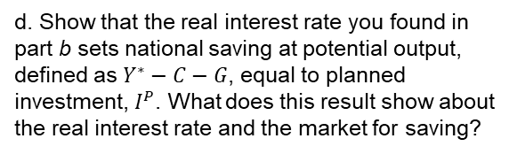
Question 2
An economy is described by the following equations.
d. Show that the real interest rate you found in part b sets national saving at potential output, defined as $Y^{∗}−C−G$, equal to planned investment, $I^{P}$. What does this result show about the real interest rate and the market for saving?
$$C=2600+0.8\left(Y−T\right)−10,000r$$
$$I^{P}=2000−10,000r$$
$$G=1800$$
$$NX=0$$
$$T=3000$$
The real interest rate, expressed as a decimal, is 0.10 (that is, 10 percent)

Slide 60

Question 2
An economy is described by the following equations.
d. Show that the real interest rate you found in part b sets national saving at potential output, defined as $Y^{∗}−C−G$, equal to planned investment, $I^{P}$. What does this result show about the real interest rate and the market for saving?
$$C=2600+0.8\left(Y−T\right)−10,000r$$
$$I^{P}=2000−10,000r$$
$$NS=Y^{∗}−C−G$$
$$G=1800$$
$$NX=0$$
$$T=3000$$
The real interest rate, expressed as a decimal, is 0.10 (that is, 10 percent)

Slide 61
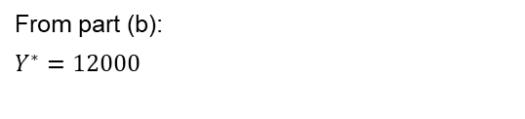
Question 2
An economy is described by the following equations.
d. Show that the real interest rate you found in part b sets national saving at potential output, defined as $Y^{∗}−C−G$, equal to planned investment, $I^{P}$. What does this result show about the real interest rate and the market for saving?
$$C=2600+0.8\left(Y−T\right)−10,000r$$
$$I^{P}=2000−10,000r$$
$$NS=Y^{∗}−C−G$$
$$G=1800$$
From part (b):
$$Y^{∗}=12000$$
$$NX=0$$
$$T=3000$$
The real interest rate, expressed as a decimal, is 0.10 (that is, 10 percent)

Slide 62
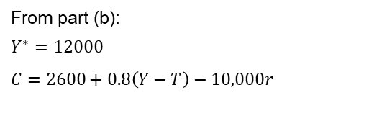
Question 2
An economy is described by the following equations.
d. Show that the real interest rate you found in part b sets national saving at potential output, defined as $Y^{∗}−C−G$, equal to planned investment, $I^{P}$. What does this result show about the real interest rate and the market for saving?
$$C=2600+0.8\left(Y−T\right)−10,000r$$
$$I^{P}=2000−10,000r$$
$$NS=Y^{∗}−C−G$$
$$G=1800$$
From part (b):
$$Y^{∗}=12000$$
$$C=2600+0.8\left(Y−T\right)−10,000r$$
$$NX=0$$
$$T=3000$$
The real interest rate, expressed as a decimal, is 0.10 (that is, 10 percent)

Slide 63
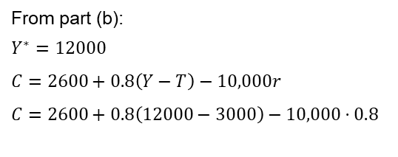
Question 2
An economy is described by the following equations.
d. Show that the real interest rate you found in part b sets national saving at potential output, defined as $Y^{∗}−C−G$, equal to planned investment, $I^{P}$. What does this result show about the real interest rate and the market for saving?
$$C=2600+0.8\left(Y−T\right)−10,000r$$
$$I^{P}=2000−10,000r$$
$$NS=Y^{∗}−C−G$$
$$G=1800$$
From part (b):
$$Y^{∗}=12000$$
$$C=2600+0.8\left(Y−T\right)−10,000r$$
$$C=2600+0.8\left(12000−3000\right)−10,000⋅0.8$$
$$NX=0$$
$$T=3000$$
The real interest rate, expressed as a decimal, is 0.10 (that is, 10 percent)

Slide 64
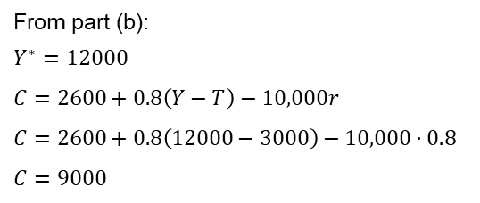
Question 2
An economy is described by the following equations.
d. Show that the real interest rate you found in part b sets national saving at potential output, defined as $Y^{∗}−C−G$, equal to planned investment, $I^{P}$. What does this result show about the real interest rate and the market for saving?
$$C=2600+0.8\left(Y−T\right)−10,000r$$
$$I^{P}=2000−10,000r$$
$$NS=Y^{∗}−C−G$$
$$G=1800$$
From part (b):
$$Y^{∗}=12000$$
$$C=2600+0.8\left(Y−T\right)−10,000r$$
$$C=2600+0.8\left(12000−3000\right)−10,000⋅0.8$$
$$C=9000$$
$$NX=0$$
$$T=3000$$
The real interest rate, expressed as a decimal, is 0.10 (that is, 10 percent)

Slide 65
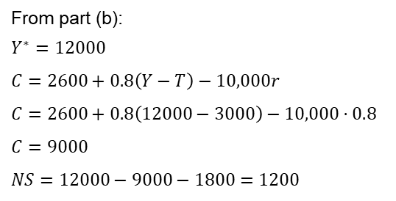
Question 2
An economy is described by the following equations.
d. Show that the real interest rate you found in part b sets national saving at potential output, defined as $Y^{∗}−C−G$, equal to planned investment, $I^{P}$. What does this result show about the real interest rate and the market for saving?
$$C=2600+0.8\left(Y−T\right)−10,000r$$
$$I^{P}=2000−10,000r$$
$$NS=Y^{∗}−C−G$$
$$G=1800$$
From part (b):
$$Y^{∗}=12000$$
$$C=2600+0.8\left(Y−T\right)−10,000r$$
$$C=2600+0.8\left(12000−3000\right)−10,000⋅0.8$$
$$C=9000$$
$$NS=12000−9000−1800=1200$$
$$NX=0$$
$$T=3000$$
The real interest rate, expressed as a decimal, is 0.10 (that is, 10 percent)

Slide 66
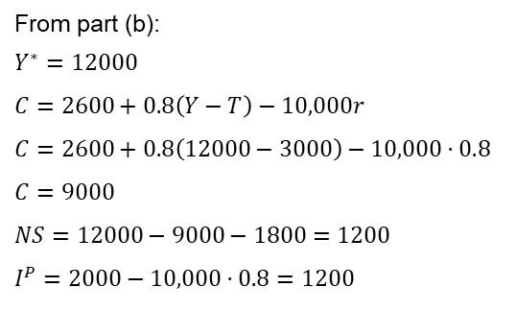
Question 2
An economy is described by the following equations.
d. Show that the real interest rate you found in part b sets national saving at potential output, defined as $Y^{∗}−C−G$, equal to planned investment, $I^{P}$. What does this result show about the real interest rate and the market for saving?
$$C=2600+0.8\left(Y−T\right)−10,000r$$
$$I^{P}=2000−10,000r$$
$$NS=Y^{∗}−C−G$$
$$G=1800$$
From part (b):
$$Y^{∗}=12000$$
$$C=2600+0.8\left(Y−T\right)−10,000r$$
$$C=2600+0.8\left(12000−3000\right)−10,000⋅0.8$$
$$C=9000$$
$$NS=12000−9000−1800=1200$$
$$I^{P}=2000−10,000⋅0.8=1200$$
$$NX=0$$
$$T=3000$$
The real interest rate, expressed as a decimal, is 0.10 (that is, 10 percent)

Slide 67
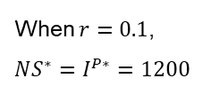
Question 2
An economy is described by the following equations.
d. Show that the real interest rate you found in part b sets national saving at potential output, defined as $Y^{∗}−C−G$, equal to planned investment, $I^{P}$. What does this result show about the real interest rate and the market for saving?
$$C=2600+0.8\left(Y−T\right)−10,000r$$
$$I^{P}=2000−10,000r$$
When $r=0.1$,
$$NS^{∗}=I^{P∗}=1200$$
$$G=1800$$
$$NX=0$$
$$T=3000$$
The real interest rate, expressed as a decimal, is 0.10 (that is, 10 percent)

Slide 68
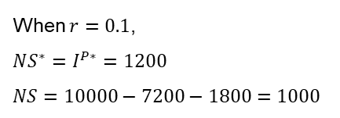
Question 2
An economy is described by the following equations.
d. Show that the real interest rate you found in part b sets national saving at potential output, defined as $Y^{∗}−C−G$, equal to planned investment, $I^{P}$. What does this result show about the real interest rate and the market for saving?
$$C=2600+0.8\left(Y−T\right)−10,000r$$
$$I^{P}=2000−10,000r$$
When $r=0.1$,
$$NS^{∗}=I^{P∗}=1200$$
$$NS=10000−7200−1800=1000$$
$$G=1800$$
$$NX=0$$
$$T=3000$$
The real interest rate, expressed as a decimal, is 0.10 (that is, 10 percent)

Slide 69
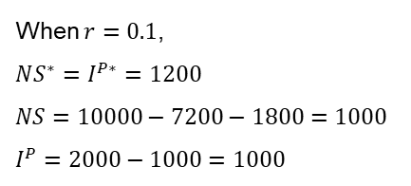
Question 2
An economy is described by the following equations.
d. Show that the real interest rate you found in part b sets national saving at potential output, defined as $Y^{∗}−C−G$, equal to planned investment, $I^{P}$. What does this result show about the real interest rate and the market for saving?
$$C=2600+0.8\left(Y−T\right)−10,000r$$
$$I^{P}=2000−10,000r$$
When $r=0.1$,
$$NS^{∗}=I^{P∗}=1200$$
$$NS=10000−7200−1800=1000$$
$$I^{P}=2000−1000=1000$$
$$G=1800$$
$$NX=0$$
$$T=3000$$
The real interest rate, expressed as a decimal, is 0.10 (that is, 10 percent)

Slide 70
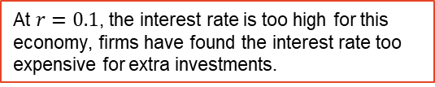
Question 2
An economy is described by the following equations.
d. Show that the real interest rate you found in part b sets national saving at potential output, defined as $Y^{∗}−C−G$, equal to planned investment, $I^{P}$. What does this result show about the real interest rate and the market for saving?
$$C=2600+0.8\left(Y−T\right)−10,000r$$
$$I^{P}=2000−10,000r$$
When $r=0.1$,
$$NS^{∗}=I^{P∗}=1200$$
$$NS=10000−7200−1800=1000$$
$$I^{P}=2000−1000=1000$$
$$G=1800$$
$$NX=0$$
$$T=3000$$
The real interest rate, expressed as a decimal, is 0.10 (that is, 10 percent)
At $r=0.1$, the interest rate is too high for this economy, firms have found the interest rate too expensive for extra investments.

